Slide 1
Professionele ruimte & academische vrijheid
Prof. Mr H.M. De Jong

Slide 2

Professional
It is useful to think of a profession as an occupation which has assumed a dominant position in a division of labour, so that it gains control over the determination of the substance of its own work.
Freidson

Slide 3
Managerialism
systemic logic, a set of routine practices, and an ideology ... a way of doing and being’ in organizations which has the ultimate goal of enhancing efficiency through control
Deetz

Slide 4
humboldt, 1810
'The notion of the higher scientific institutions, as the pinnacle where everything that happens directly for the moral culture of the nation comes together, is based on the idea that they are destined to work on science in the deepest and broadest sense of the word, and hand it over as subject matter to be used by intellectual and moral education, suitably prepared for this purpose, not intentionally so but by itself.'

Slide 5

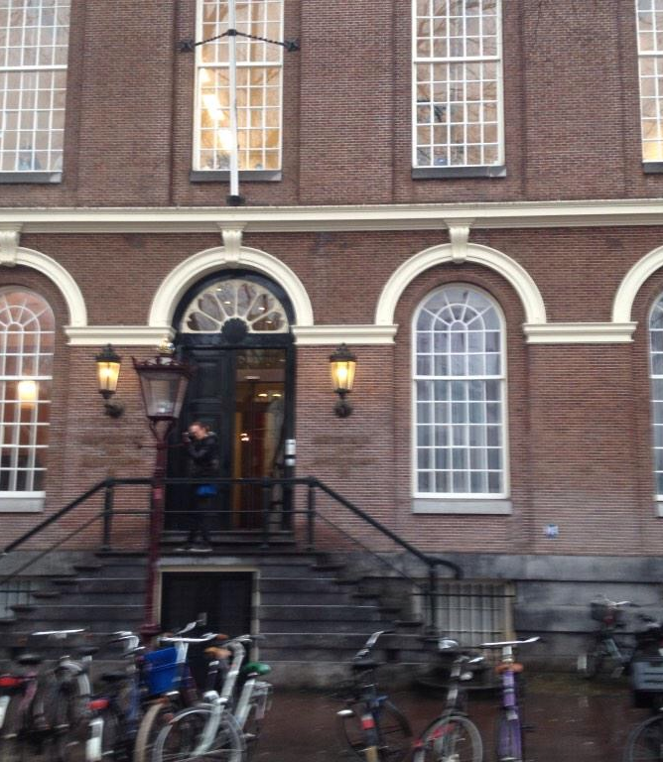
Spanning
Academie
Universiteit

Slide 6
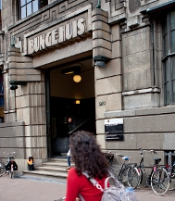
Organisatie
Leerstoelen
Faculteiten (disciplines)
'Disciplinevorming'

Slide 7
Massificatie & schaal
UvA: 31.000 studenten; 4.410 fte
VU: 25.000 studenten; 2.800 fte

Slide 8
Schisma?
Kerntaken
Ondersteunende taken

Slide 9
Binaire stelsel
Universiteit
Hogeschool (1986, fusies)

Slide 10
HvA
50.000 studenten; 3.593 fte
UvA: 31.000 studenten; 4.410 fte
VU: 25.000 studenten; 2.800 fte

Slide 11
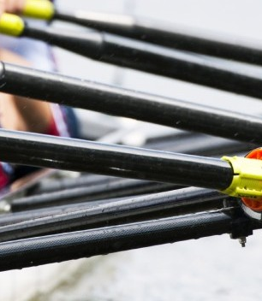
Omdenken
'Professional in the lead'

Slide 12
Tot slot
Naar een netwerkorganisatie

